Slide 1


Object Detection Using YOLO V8
TEAM:
BRUTE FORCE

Slide 2

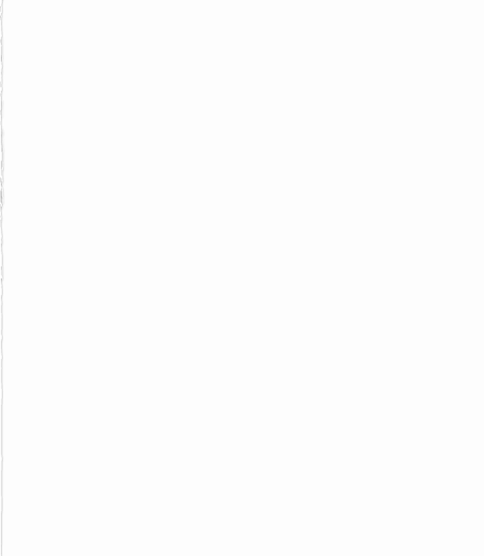
CONTENTS
Problem Statement
Introduction
Technology Used
Python Libraries
IP Phone Camera App
Implementation

Slide 3
PROBLEM STATEMENT
Develop a model that can identify and track objects in real-time video streams. Use deep learning algorithms such as convolutional neural networks to identify objects and track their movements over time.

Slide 4
INTRODUCTION
Object detection and tracking in real-time video streams are important tasks in computer vision, with numerous applications in fields such as autonomous driving, surveillance, and robotics.
Deep learning algorithms, such as convolutional neural networks, have demonstrated excellent performance in these tasks.
In this project, we aim to develop a model that can identify and track objects in real-time video streams using the YOLOv8 algorithm.
Overall, the goal of this project is to create a reliable and accurate object detection and tracking system that can be applied in a wide range of real-world applications.

Slide 5
TECHNOLOGY USED
Python Libraries
Numpy - NumPy provides efficient and fast operations on multi-dimensional arrays, which are commonly used in deep learning frameworks such as TensorFlow and PyTorch.
Open CV - OpenCV provides pre-processing functions such as image resizing, color conversion, and image filtering, which are essential for preparing the video stream data for input into the deep learning model
Torch -Torch is used in this context to accelerate the training and inference of deep learning models, providing a reliable and efficient platform for implementing complex computer vision tasks such as object detection and tracking in real-time video streams.
Ultralytics-YOLOv8 is used as the object detection algorithm, which is an improved version of YOLOv5 created by Ultralytics.

Slide 6
IP Phone Camera App
The IP Phone Camera app is a mobile application that allows users to turn their smartphone into an IP camera, which can be accessed and monitored remotely. Users can use their phone's camera to stream a live feed that can be accessed from anywhere with an internet connection.
This app is perfect for users who want to monitor their home or office remotely, or for businesses that want to keep an eye on their premises. The app also provides motion detection features and can send notifications when movement is detected.
The IP Phone Camera app is easy to set up and use, making it a convenient and cost-effective solution for remote monitoring.
This app is used in our project for feeding the Realtime videos to the Algorithm for required Output.

Slide 7
IMPLEMENTATION
The video is captured in mobile phone and broadcasted in local WIFI network.
Then the video is converted into frames using OpenCV VideoCapture() method ,resized and fed into YOLO V8 Algorithm.
Then the YOLO V8 method process and produces a tensor array
The square Box displayed is over the detected object is called as BOUNDING BOX.
Then the output video is displayed on the screen.

Slide 8
BLOCK DIAGRAM
INPUT FORMAT MODEL
MODEL + TRACKING (YOLO)
OUTPUT(VIDEO STREAMING)
MOBILE
LIVE CAPTURE
USER INTERFACE

